Slide 1


My Timetable database

Slide 2
My Timetable database

Slide 3

Why did I create this database?
During my school and university years, I extensively used timetables. I remember how meticulously my teachers prepared these timetables and the time they spent on them. Therefore, I have always found the preparation of timetables intriguing. Since timetables play a crucial role in the field of education, I decided to create a database for managing school and university timetables, aiming to enhance the efficiency of organization. Moreover, it can be organized to prevent conflicts over the use of resources by ensuring that classes, teachers, and resources are not reserved twice at the same time. Timetables need frequent adjustments due to unforeseen events. Remember that a database allows for easy updates and changes. Thus, from this database, we will obtain comprehensive information on how schedules are created.
My Timetable database
Sevda Heydarova

Slide 4
Why did I create this database?
During my school and university years, I extensively used timetables. I remember how meticulously my teachers prepared these timetables and the time they spent on them. Therefore, I have always found the preparation of timetables intriguing. Since timetables play a crucial role in the field of education, I decided to create a database for managing school and university timetables, aiming to enhance the efficiency of organization. Moreover, it can be organized to prevent conflicts over the use of resources by ensuring that classes, teachers, and resources are not reserved twice at the same time. Timetables need frequent adjustments due to unforeseen events. Remember that a database allows for easy updates and changes. Thus, from this database, we will obtain comprehensive information on how schedules are created.

Slide 5

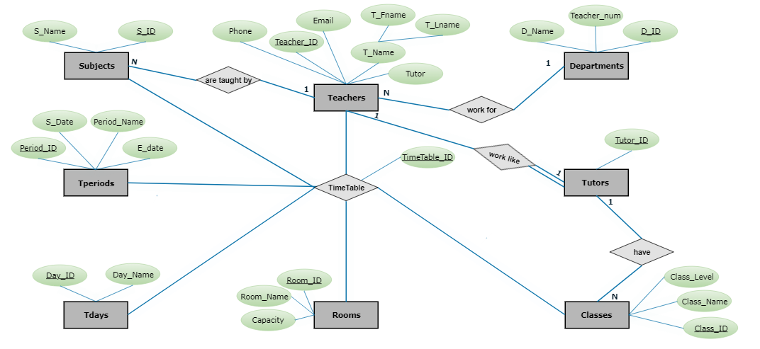
EER Diagram of my database

Slide 6
Entities
Relations
Teachers
Subjects
Departments
Tperiods
Tdays
Rooms
Classes
Tutors
Are taught by
Work for
Work like
Have
TimeTable

Slide 7
Entities
Relations
Teachers
Subjects
Departments
Tperiods
Tdays
Rooms
Classes
Tutors
Are taught by
Work for
Work like
Have
TimeTable

Slide 8
Attributes
For teachers
For subjects
For departments
For Tperiods
Teacher_ID
T_Fname
T_Lname
Email
Phone
Tutor
S_ID
S_Name
D_ID
D_Name
Teacher_num
Period_ID
Period_Name
S_Date
E_date

Slide 9
Attributes
For teachers
For subjects
For departments
For Tperiods
Teacher_ID
T_Fname
T_Lname
Email
Phone
Tutor
S_ID
S_Name
D_ID
D_Name
Teacher_num
Period_ID
Period_Name
S_Date
E_date

Slide 10
Attributes
For teachers
For subjects
For departments
For Tperiods
Teacher_ID
T_Fname
T_Lname
Email
Phone
Tutor
S_ID
S_Name
D_ID
D_Name
Teacher_num
Period_ID
Period_Name
S_Date
E_date

Slide 11
Attributes
For teachers
For subjects
For departments
For Tperiods
Teacher_ID
T_Fname
T_Lname
Email
Phone
Tutor
S_ID
S_Name
D_ID
D_Name
Teacher_num
Period_ID
Period_Name
S_Date
E_date

Slide 12
Attributes
For Tdays
For Rooms
For Classes
For Tutors
Day_ID
Day_Name
Room_ID
Room_Name
Capacity
Class_ID
Class_Name
Class_Level
Tutor_ID

Slide 13
Attributes
For Tdays
For Rooms
For Classes
For Tutors
Day_ID
Day_Name
Room_ID
Room_Name
Capacity
Class_ID
Class_Name
Class_Level
Tutor_ID

Slide 14
Attributes
For Tdays
For Rooms
For Classes
For Tutors
Day_ID
Day_Name
Room_ID
Room_Name
Capacity
Class_ID
Class_Name
Class_Level
Tutor_ID

Slide 15
Attributes
For Tdays
For Rooms
For Classes
For Tutors
Day_ID
Day_Name
Room_ID
Room_Name
Capacity
Class_ID
Class_Name
Class_Level
Tutor_ID

Slide 16
Description of my database
In this database I have Teachers, Subjects, Departments, Tperiods, Tdays, Rooms, Classes, Tutors tables. Teachers table has columns like Teacher_ID, Phone, Email, Tutor that is boolean value and is giving True or False values and one composite column that is consist of First name(T_Fname) and Last name(T_Lname). Teacher_ID is primary key that means this column can not be Null and same value: all values should be unique. Teacher table is related to Departments table with "work for" relation. It is one to many relation. What does it mean?
It means that 1 Teacher can work for only 1 Department but 1 Department can have many Teachers. In this relation we will use foreign key- D_ID that is one of columns of Departments table. D_ID is also primary key for Departments table.
Other columns of Departments table are Department Name(D_Name) and Number of teachers work for same department(Teacher_num)

Slide 17
Description of my database
Teachers table is related to Subjects table with " taught by" relation. It is one to many relation. What does it mean?
It means that 1 Teacher can teach many Subjects but 1 Subject can be taught by 1 Teacher. In this relation we will use foreign key- Teacher_ID that is one of columns of Teachers table. Teacher_ID is also primary key for Teachers table as you know.
Other columns of Subjects table are S_ID that is primary key and Subject Name(S_Name).
Teachers table is also related to Tutors table with " work like" relation. It is one to one relation. What does it mean?
It means that 1 Teacher can work like only 1 Tutor and 1 Tutor can be just 1 Teacher. " work like" relation consist of 2 part: Partial(single line) and total participation(double line). What is total and partial participation?
It means that each Tutor is also a Teacher, but each Teacher is not Tutor.
So, In this relation we have foreign key- Teacher_ID again.

Slide 18
Description of my database
Another column of Tutors table is Tutor_ID that is primary key for Tutors table.
Tutors table is related to Classes table with " have" relation. It is one to many relation. What does it mean?
It means that 1 Tutor can have many Classes but 1 Class can have just 1 Tutor. In this relation we will use foreign key- Tutor_ID that is one of columns of Tutors table. Tutor_ID is also primary key for Tutors table as you know.
Other columns of Classes table are Class_ID that is primary key, Class_Name and Class_Level.
Columns of Rooms table are Room_ID like primary key, Room_Name and Capacity.
Columns of Tdays table are Day_ID like primary key, Day_Name(Monday, Tuesday, Wednesday, Thursday, Friday or Saturday)

Slide 19
Description of my database
Columns of Tperiods table are Period_ID like primary key, Period_Name, S_Date(Start date) and E_date(End date).
There is n-ary relation that was called like " TimeTable" relation among Teachers, Subjects, Tperiods, Tdays, Rooms, Classes tables. " TimeTable" relation has own attribute: TimeTable_ID that is primary key. Hence, we created table that was called like TimeTable. Its columns are TimeTable_ID like primary key of TimeTable table and Teacher_ID, S_ID, Class_ID, Day_ID, Room_ID, Period_ID like foreign keys that are primary keys of Teachers, Subjects, Classes, Tdays, Rooms, Tperiods tables respectively.

Slide 20
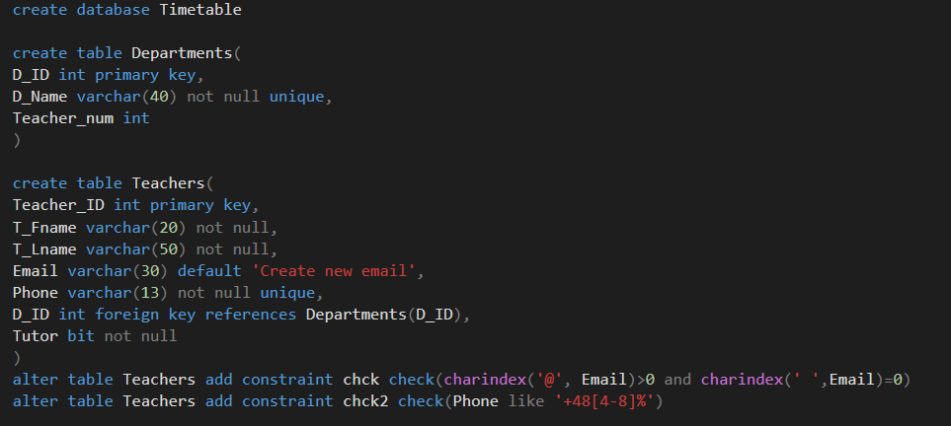
Commands on MS SQL Server for my database
Notes: First, I created my database. Then I created my tables one by one with its columns. In my data base I have constraints: chck, chck2, chck3. I will explain them in following pages.

Slide 21
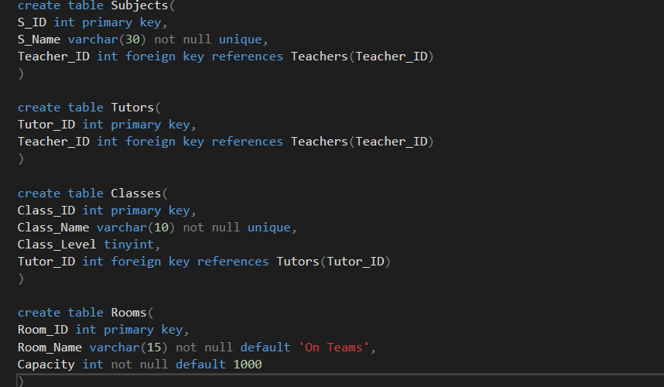
Commands on MS SQL Server for my database
Notes: I created Subjects, Tutors, Classes and Rooms tables with its columns and constraints here. As I said I will inform about all constraints in following pages.

Slide 22
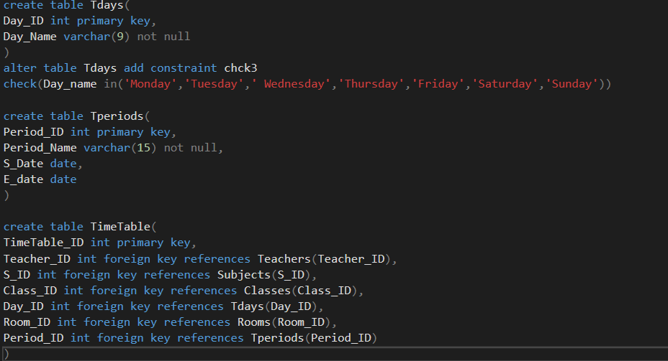
Commands on MS SQL Server for my database
Notes: I created Tdays, Tperiods and TimeTable tables with its columns and constraints here.
You can see constraint chck3 here.

Slide 23
Constraints
Not null- column can not be Null
For example: In Departments table we can not insert Null value or pass for Department name(for D_Name column)
Unique- All values in column should be different
For example: Every Department name should be different. You can not insert same names in D_Name column.
Primary key- combination of Not null and Unique constraints. You already know.
Foreign key- links tables and prevent actions that would destroy links between table.
For example Teachers table links to Departments table with helping of D_ID
Default- if no values, sets default value
For example: In Teachers table if we don’t insert any value for Email column, then SQL will insert ' Create new email’ value for Email column automatically.
Check- values in column satisfy specific rule.
For example: If you insert any value without @-sign or with any space, in chck constraint column will demand insert value in correct format for email.
In chck2 constraint will check if phone that was added, isa Polish number.
And In chck3 constraint will demand to insert true name of day like Monday, Tuesday, Wednesday, Thursday, Friday or Saturday.

Slide 24
Quick explanation of my database
At any school or university there are departments like math, biology, chemistry, computer science etc. Each department has many teachers.
And Each Teacher teach some subjects to students. Some teachers have duty as Tutor. If any teacher is tutor, this means that she or he has class or classes. At university there are a lot of lesson rooms that teachers give lectures to classes. And Each class has name, level like(1st,2nd etc) etc. Each lesson is taught during some period that has start and end date. In timetable or schedule you can see which subject on which day, is taught by which teacher, for which class, will be in which room or will be taught in which period.

Slide 25
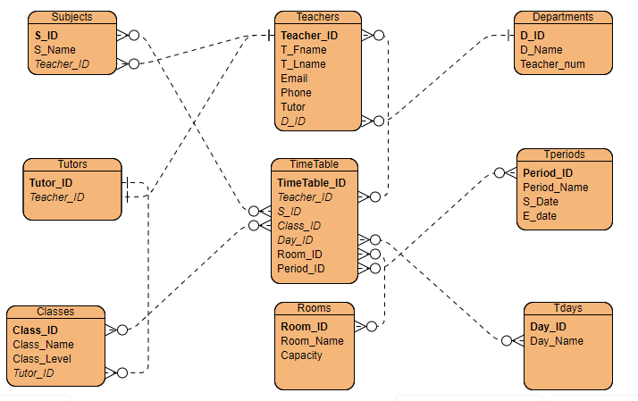
Mapping of ER/EER model to Relational model

Slide 26

Got question?
Gmail: sevdaheyder1234@gmail.com

